Slide 1


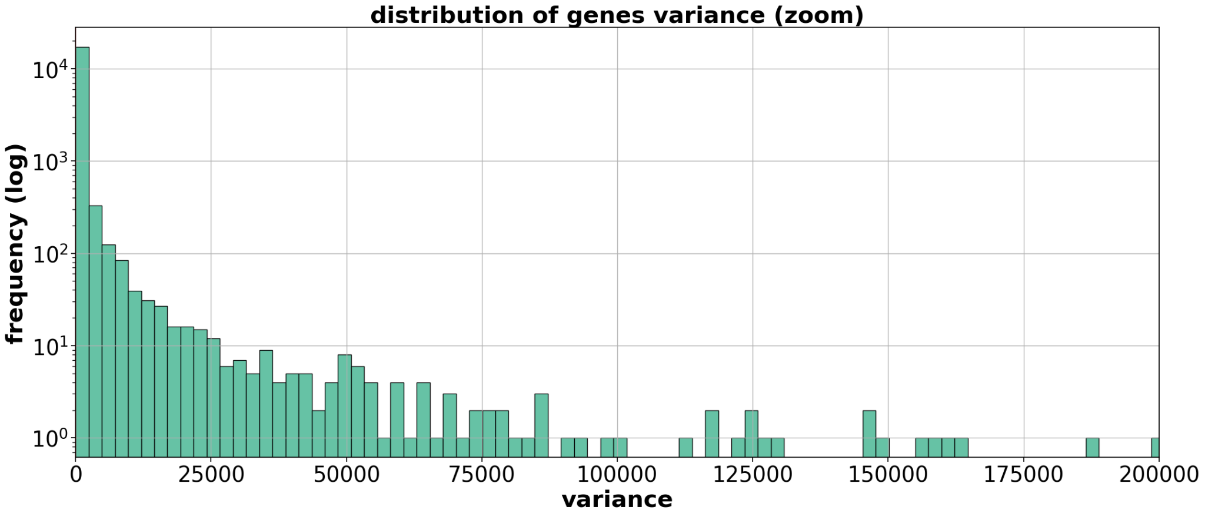
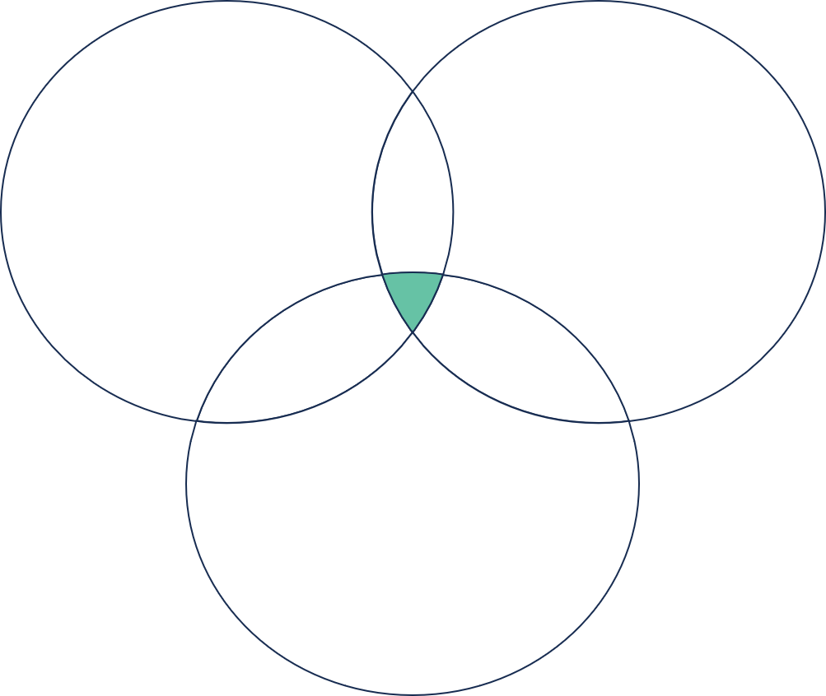
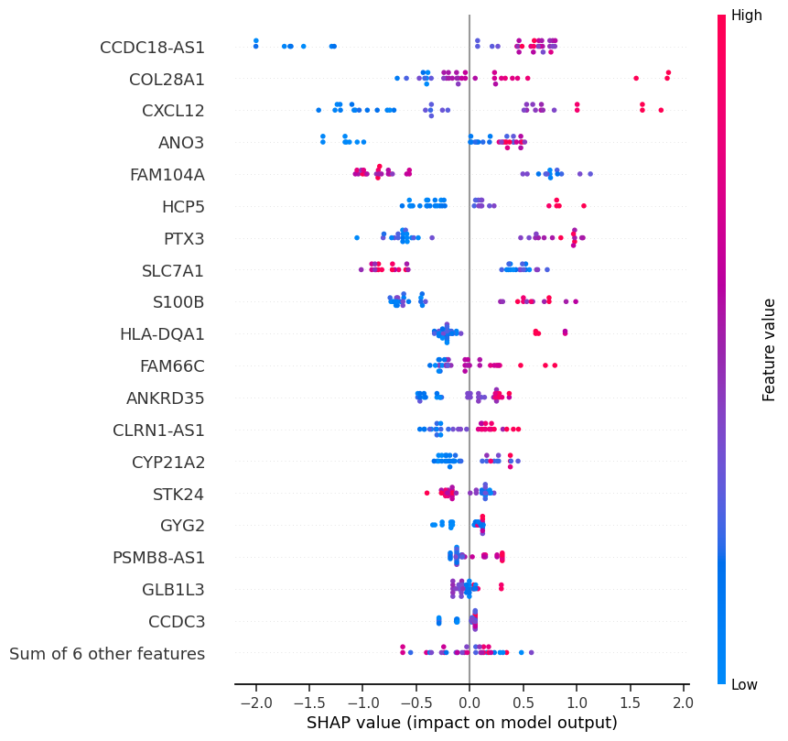




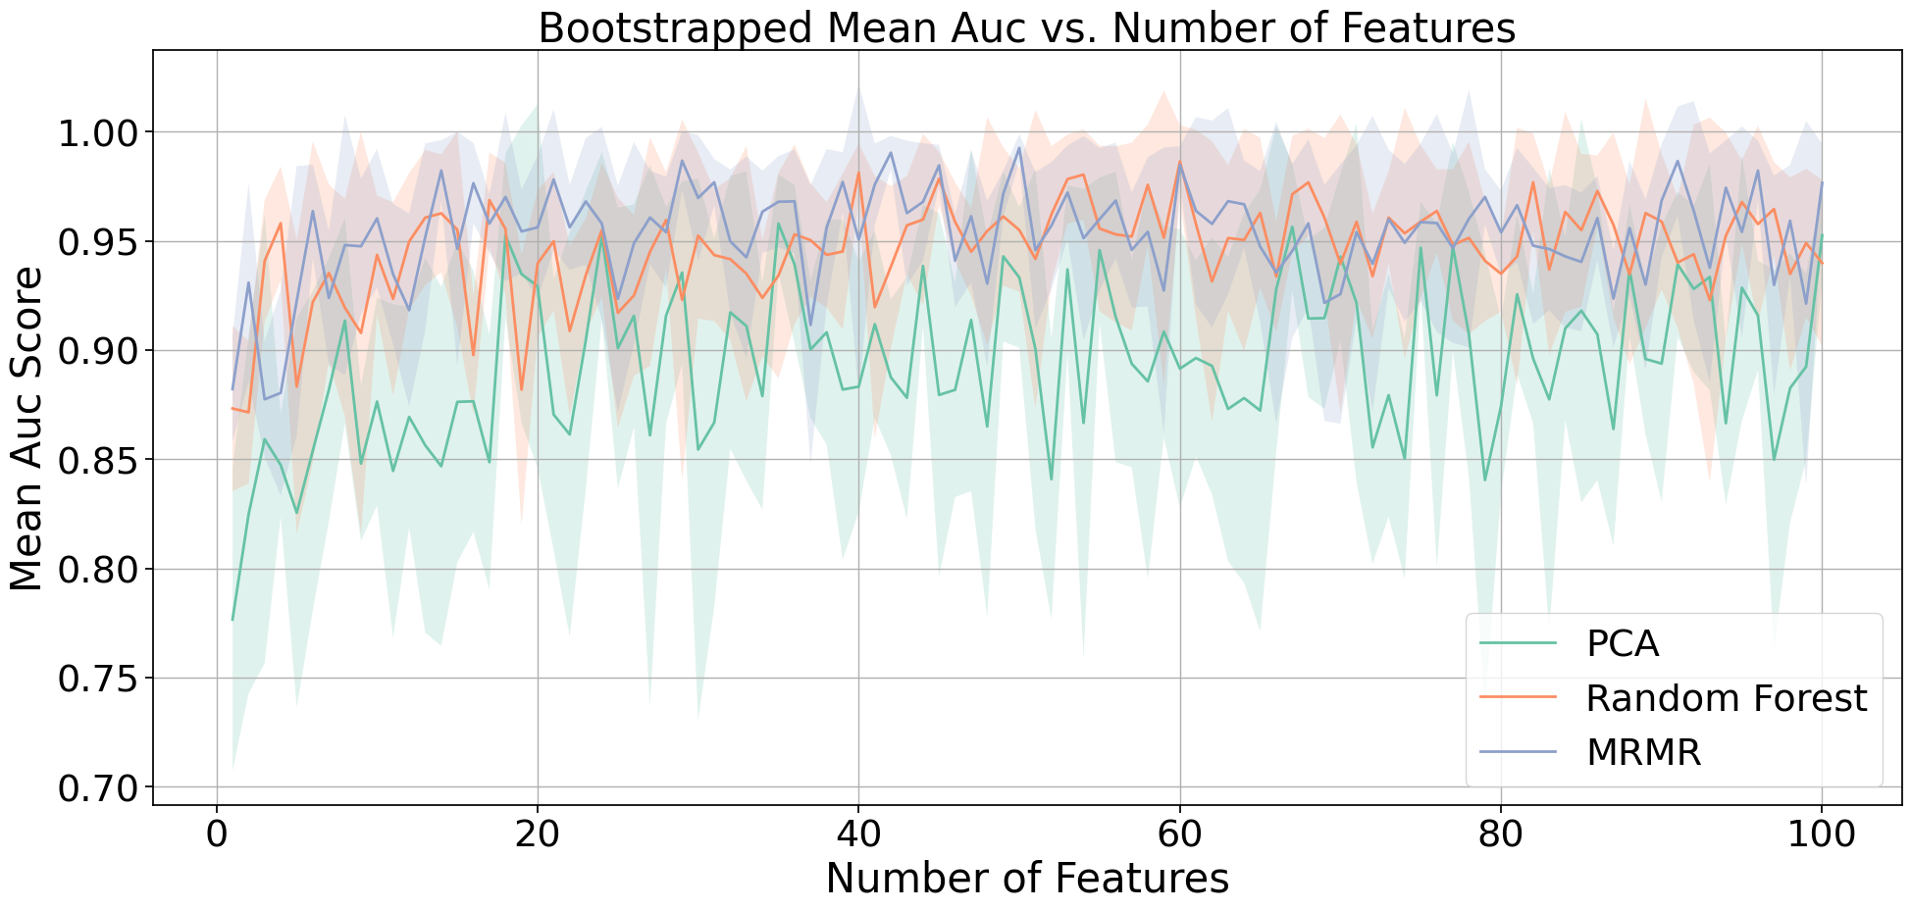
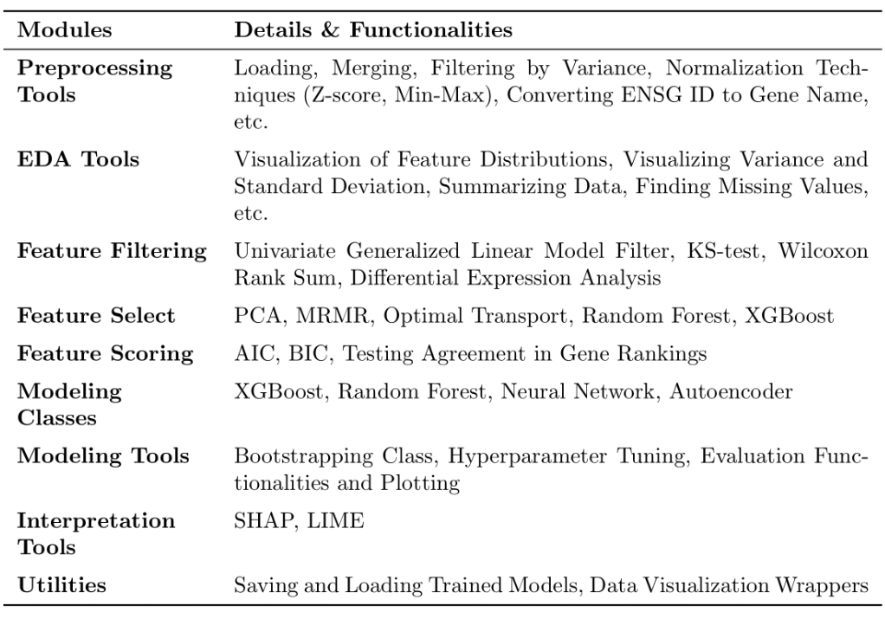






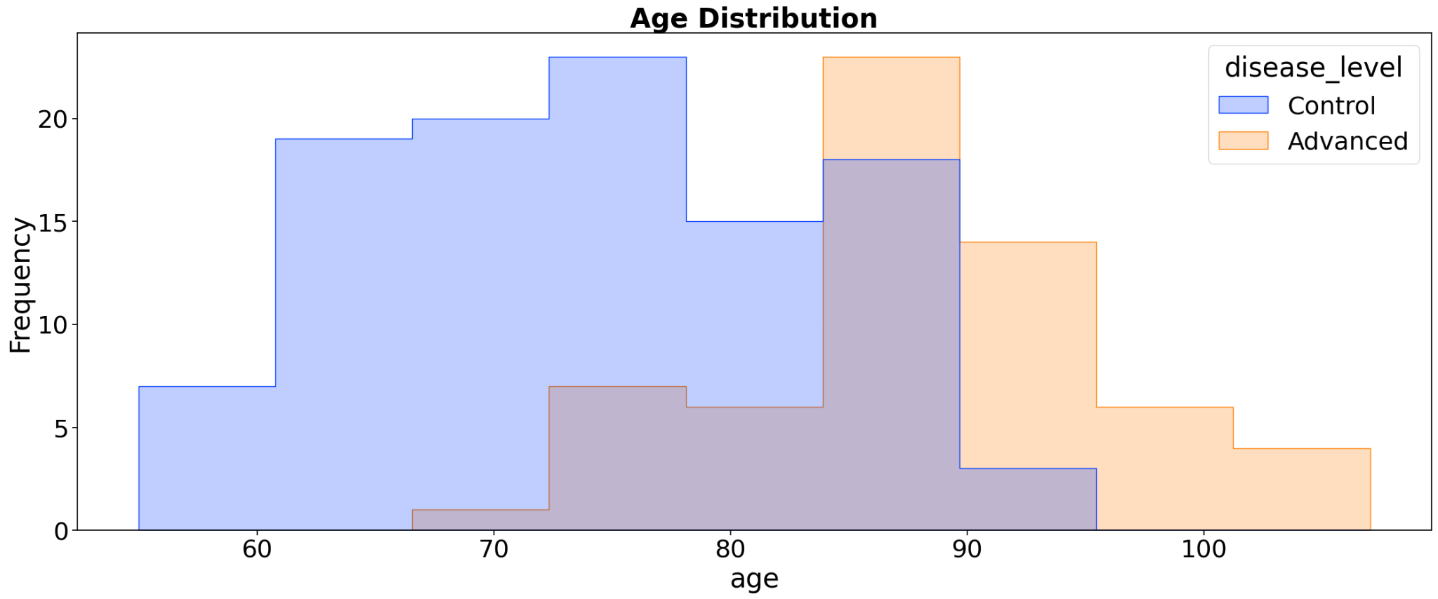
Interpretable Machine Learning Pipeline to Identify Genomic Signatures in Age-Related Macular Degeneration
Duy Ha, Patrick Yee, Qingxin Yuan, Sujitha Ravichandran, Tian Xia, Wanying Xu
Sponsor: Rinki Ratnapriya; Faculty Mentor: Arko Barman; Mentor: Maryam Khalid
Background and Objective
System Modeling & Results
Model Interpretation
Age-related Macular Degeneration (AMD):
AMD is a leading cause of vision loss in the elderly, impacting millions in the US alone.
AMD is caused by genetic and environmental factors.
Current Challenges: There's substantial difficulty in translating DNA variants to biological understanding, impeding progress on finding specific genes causing AMD.
The complexity of AMD lies in its combination of genetic variants, curse of dimensionality and gene processing complexity.
Little is known about the risk factors of AMD.
Objectives:
Development of an interpretable machine-learning pipeline to predict AMD from Genomic data.
Discover crucial genomic signatures that contribute to AMD
Development of generalizable Python Package for Gene analysis for complex diseases.
Broader Application: the pipeline and Python package are generalized for other complex diseases.
Step 1: Statistical filtering: filtering features using gene variance and statistical methods
Interpretation of XGBoost with mRMR feature selection method
Shapley Additive Explanations (SHAP)
Threshold line = 0.5
Removed ~10% of genes
Differential Expression Analysis
Wilcoxon Rank-Sum Test
SHAP applies game theoretic approach to explain the output of machine learning model and breaks down a prediction to show the impact of each feature.
Kolmogorov-Smirnov Test
652 Genes
Highly expressed genes in AMD subjects | Highly expressed genes in Control subjects
CCDC18-AS1, COL28A1, CXCL12 | FAM104A, SLC7A1
Step 2: Feature selection
Principal Component Analysis (PCA)
Ranks genes by the number of times they appear at top principal components with certain cutoff
Random Forest
Selects genes using the average permutation-based feature importance over 100 bootstrapped resamples
Minimum-Redundancy Maximum-Relevance (MRMR)
Identifies features that maximizes the algorithm’s predictive power using an f-statistic relevance score and minimized redundancy using Pearson correlation
AMD Progression leads to vision loss
DREAMR Package
Dimensionality Reduction, (feature) Extraction, and Modeling for RNA
We developed a deployable and generalizable genomic analytics package for medical professionals!
AMD Prediction & Gene Discovery Pipeline
1. Get rid of low-variance genes
2. Statistical filters:
- DEA, rank-sum, KS
Use supervised methods to rank genes based on predictive ability
Early stopping at 25 genes
Data
Filter
Feature importance
Data with selected
features
Interpretation
Modeling
Choose top k
Step 3: Modeling using XGBoost (eXtreme Gradient Boosting)
Used bootstrapping and hyperparameter tuning on selected Top 25 genes
Conclusion
SHAP
LIME
XGBoost, RF, Neural Network
PCA, MRMR, Random Forest, Autoencoder
Methods +XGBoost | Precision | Sensitivity | Specificity | F1 Score | AUC
PCA | 0.840 ± 0.067 | 0.829 ± 0.068 | 0.924 ± 0.085 | 0.824 ± 0.068 | 0.835 ± 0.055
MRMR | 0.900 ± 0.052 | 0.894 ± 0.054 | 0.922 ± 0.065 | 0.893 ± 0.054 | 0.946 ± 0.056
Random Forest | 0.873 ± 0.021 | 0.870 ± 0.023 | 0.931 ± 0.028 | 0.869 ± 0.023 | 0.930 ± 0.037
DREAMR: Developed a generalizable genomic analytics package, featuring comprehensive data preprocessing, feature filtering and selection, modeling, and evaluation techniques and functionalities.
Using DREAMR's Pipeline for AMD Findings
Models classified AMD patients with high performance (~0.98 AUC).
Interpretation (SHAP and LIME) identified potential disease-causing genes.
Best performing models may not show all significant genes
e.g. MRMR's inherent nature to exclude redundant genes
DREAMR provides a variety of models for users to choose according to their needs.
Future Improvements:
Plans to extend DREAMR's capabilities to handle multiclass classification problems.
Potential usage example: classify AMD patients for multiple disease stages.
Data Description
Genomic Data:
18056 Genes from 453 patients
105 samples with normal AMD levels
61 samples with advanced AMD levels
MRMR feature selection method + XGBoost model perform the best for AMD patient classification.
Random Forest feature selection method + XGBoost model has the least standard deviation and thus it is the most stable model.
Notes:
TO DO:
(done) Background: clear vs blur
Objective: include python package
(done) Interpretation: change model (XGBoost + MRMR?)
Results: table of performance (F1) and accuracy from all models
(done) remove the distribution of age graph in distribution of age
add summary section
goal
prediction
find all important genes

Slide 2
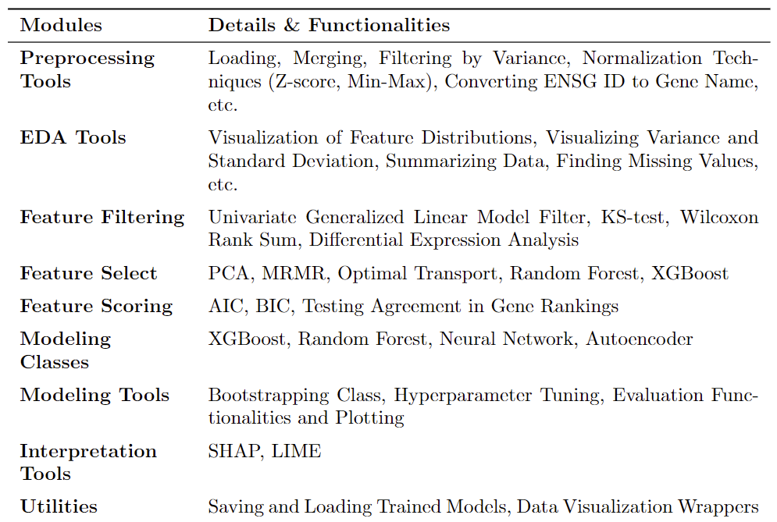
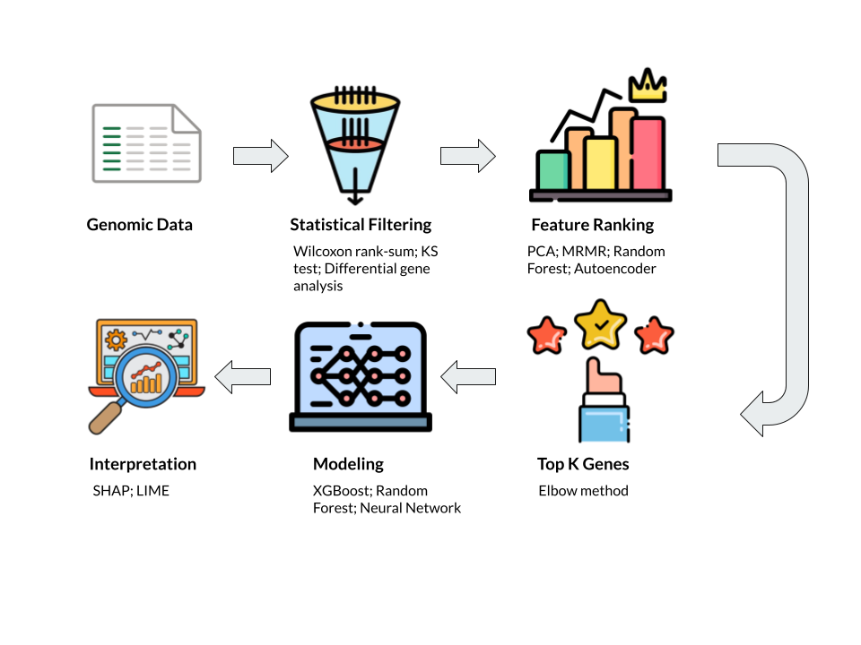
Interpretable Machine Learning Pipeline to Identify Genomic Signatures in Age-Related Macular Degeneration
Duy Ha, Patrick Yee, Qingxin Yuan, Sujitha Ravichandran, Tian Xia, Wanying Xu
Sponsor: Rinki Ratnapriya; Faculty Mentor: Arko Barman; Mentor: Maryam Khalid
Background and Objective
System Modeling & Results
Model Interpretation
Age-related Macular Degeneration (AMD):
AMD is a leading cause of vision loss in the elderly, impacting millions in the US alone.
AMD is caused by genetic and environmental factors.
Current Challenges: There's substantial difficulty in translating DNA variants to biological understanding, impeding progress on finding specific genes causing AMD.
The complexity of AMD lies in its combination of genetic variants, curse of dimensionality and gene processing complexity.
Little is known about the risk factors of AMD.
Objectives:
Development of an interpretable machine-learning pipeline to predict AMD from Genomic data.
Discover crucial genomic signatures that contribute to AMD
Development of generalizable Python Package for Gene analysis for complex diseases.
Broader Application: the pipeline and Python package are generalized for other complex diseases.
Step 1: Statistical filtering: filtering features using gene variance and statistical methods
Interpretation of XGBoost with mRMR feature selection method
Shapley Additive Explanations (SHAP)
SHAP applies game theoretic approach to explain the output of machine learning model and breaks down a prediction to show the impact of each feature.
Threshold line = 0.5
Removed ~10% of genes
Differential Expression Analysis
Wilcoxon Rank-Sum Test
Kolmogorov-Smirnov Test
Highly expressed genes in AMD subjects: CCDC18-AS1, COL28A1, CXCL12
Highly expressed genes in Control subjects: FAM104A, SLC7A1
652 Genes
Step 2: Feature selection
Principal Component Analysis (PCA)
Ranks genes by the number of times they appear at top principal components with certain cutoff
Random Forest
Selects genes using the average permutation-based feature importance over 100 bootstrapped resamples
Minimum-Redundancy Maximum-Relevance (MRMR)
Identifies features that maximizes the algorithm’s predictive power using an f-statistic relevance score and minimized redundancy using Pearson correlation
AMD Progression leads to vision loss
DREAMR Package
Dimensionality Reduction, (feature) Extraction, and Modeling for RNA
We developed a deployable and generalizable genomic analytics package for medical professionals!
AMD Prediction & Gene Discovery Pipeline
Early stopping at 25 genes
Step 3: Modeling using XGBoost (eXtreme Gradient Boosting)
Used bootstrapping and hyperparameter tuning on selected Top 25 genes
Conclusion
Methods +XGBoost | Precision | Sensitivity | Specificity | F1 Score | AUC
PCA | 0.840 ± 0.067 | 0.829 ± 0.068 | 0.924 ± 0.085 | 0.824 ± 0.068 | 0.835 ± 0.055
MRMR | 0.900 ± 0.052 | 0.894 ± 0.054 | 0.922 ± 0.065 | 0.893 ± 0.054 | 0.946 ± 0.056
Random Forest | 0.873 ± 0.021 | 0.870 ± 0.023 | 0.931 ± 0.028 | 0.869 ± 0.023 | 0.930 ± 0.037
DREAMR: Developed a generalizable genomic analytics package, featuring comprehensive data preprocessing, feature filtering and selection, modeling, and evaluation techniques and functionalities.
Using DREAMR's Pipeline for AMD Findings
Models classified AMD patients with high performance (~0.95 AUC).
Interpretation (SHAP and LIME) identified potential disease-causing genes.
Best performing models may not show all significant genes
e.g. MRMR's inherent nature to exclude redundant genes
DREAMR provides a variety of models for users to choose according to their needs.
Future Improvements:
Plans to extend DREAMR's capabilities to handle multiclass classification problems.
Potential usage example: classify AMD patients for multiple disease stages.
Data Description
Genomic Data:
18056 Genes from 453 patients
105 samples with normal AMD levels
61 samples with advanced AMD levels
Conclusion: MRMR feature selection method + XGBoost model perform the best for AMD patient classification.
Notes:
TO DO:
(done) Background: clear vs blur
Objective: include python package
(done) Interpretation: change model (XGBoost + MRMR?)
Results: table of performance (F1) and accuracy from all models
(done) remove the distribution of age graph in distribution of age
add summary section
goal
prediction
find all important genes

Slide 3
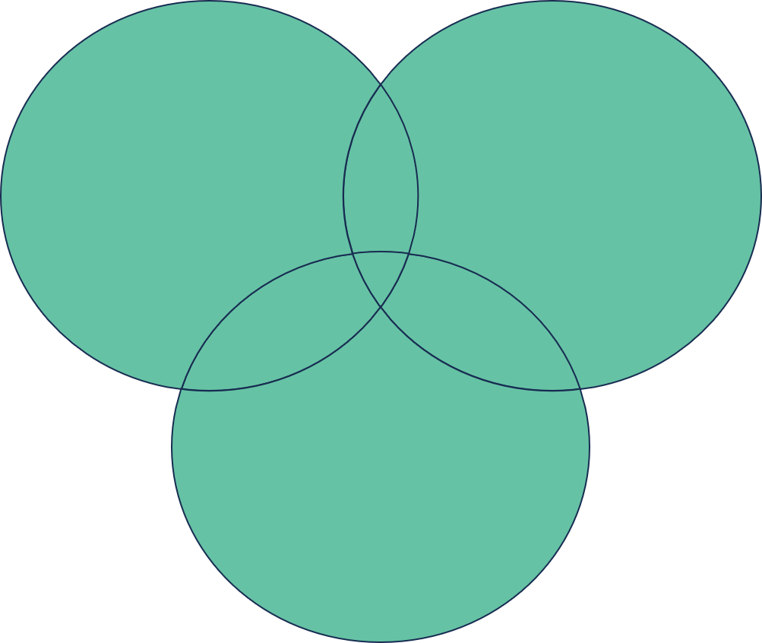
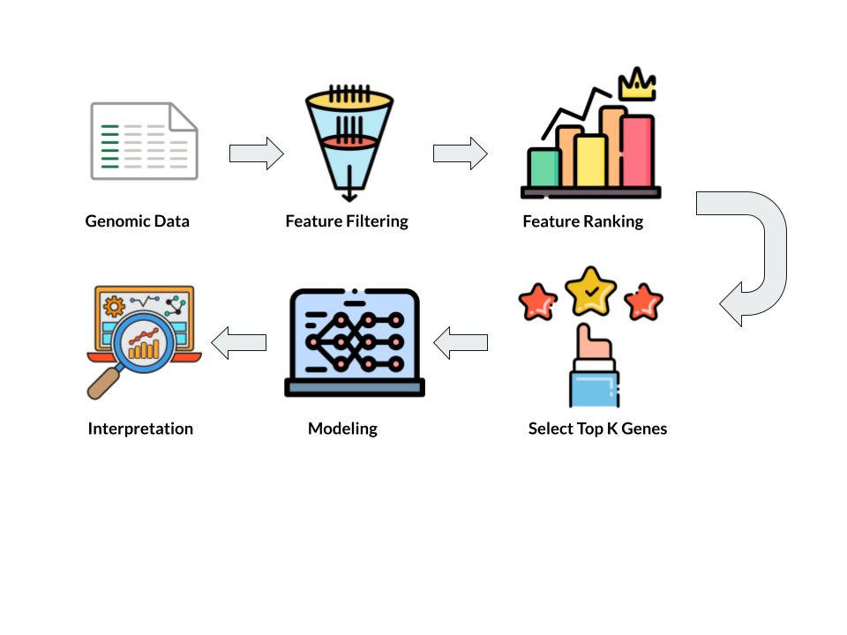
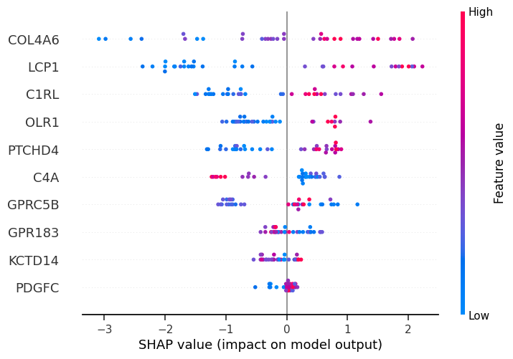
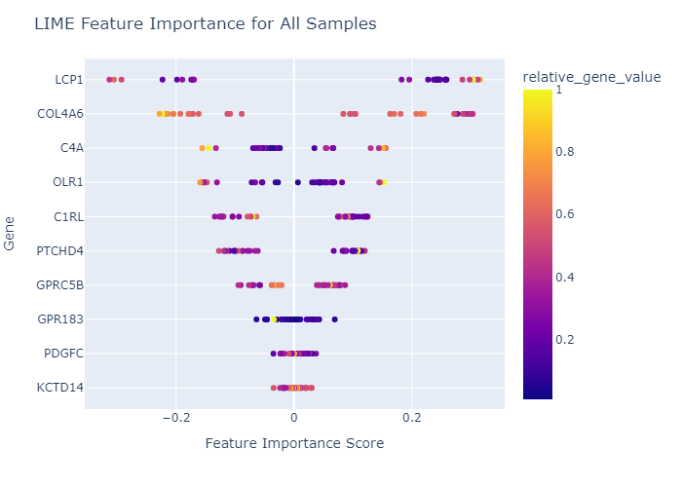

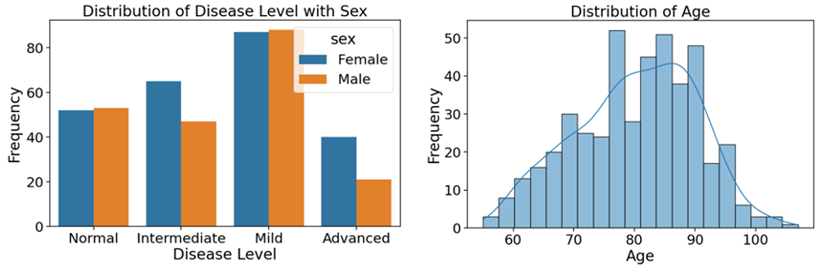
Interpretable Machine Learning Pipeline to Identify Genomic Signatures in Age-Related Macular Degeneration
Duy Ha, Patrick Yee, Qingxin Yuan, Sujitha Ravichandran, Tian Xia, Wanying Xu
Sponsor: Rinki Ratnapriya; Faculty Mentor: Arko Barman; Mentor: Maryam Khalid
Background
Methods
Results and Explanation
Age-related Macular Degeneration (AMD) is a leading cause of vision loss in the elderly which affects millions of people in the United States alone.
Complexity: The disease is influenced by a combination of genetic variants, environmental stress, and advanced aging.
Current Challenges: Despite advances in genomics, difficulties in translating DNA variants to biological understanding have impeded progress in understanding AMD and developing new therapies.
Threshold line = 0.5
Removed ~10% of genes
Plot for XGBoost with RF
Project Objective
Development of a Pipeline: Create an interpretable machine-learning pipeline to identify crucial genomic signatures in AMD.
Goals:
Accelerate understanding of AMD.
Contribute to the development of effective therapies.
Broader Application: The pipeline is designed to be generalizable for addressing challenges in detecting subtle genomic changes.
Step 1: Filtering features using gene variance and removing low variance genes
Differential Expression Analysis
Wilcoxon Rank-Sum Test
Differential Expression Analysis
Wilcoxon Rank-Sum Test
Features vs F1 scores for XGBoost model with Random Forest feature selection method
(description & discussion)
Data Science Pipeline
Kolmogorov-Smirnov Test
2486 Genes
Kolmogorov-Smirnov Test
652 Genes
Step 2: Filtering features using statistical methods and then taking union and intersection
Plot for PCA
Plot for mRMR
Plot for RF
SHAP and LIME interpretation for XGBoost model with Random Forest feature selection method
Step 3: Selecting features using Principal Component Analysis, Minimum-Redundancy Maximum-Relevance, and Random Forest
Data Description
18056 Genes from 453 patients
105 samples with normal AMD levels
175 samples with early AMD levels
112 samples with intermediate AMD levels
61 samples with advanced AMD levels
Plot for XGBoost
Plot for RF
Summary
Step 4: Modeling using XGBoost and Random Forest and tuning hyperparameters

Slide 4
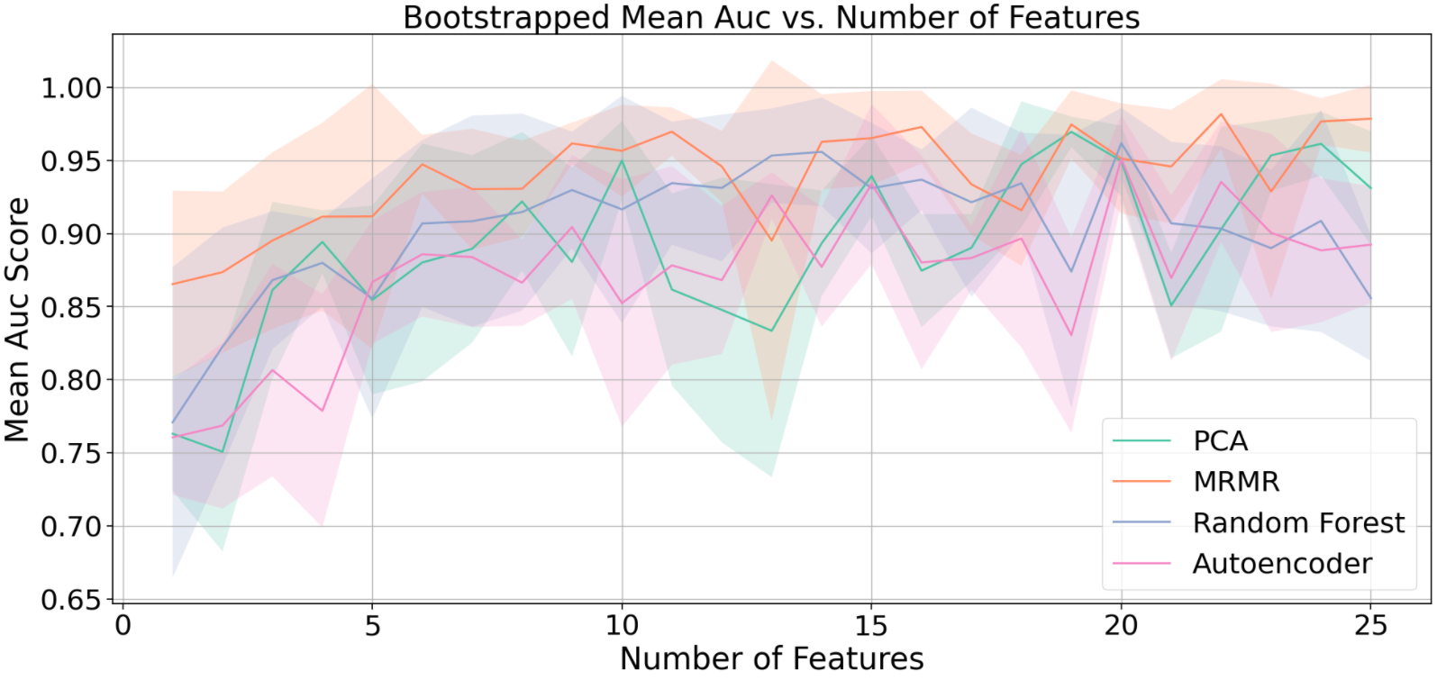
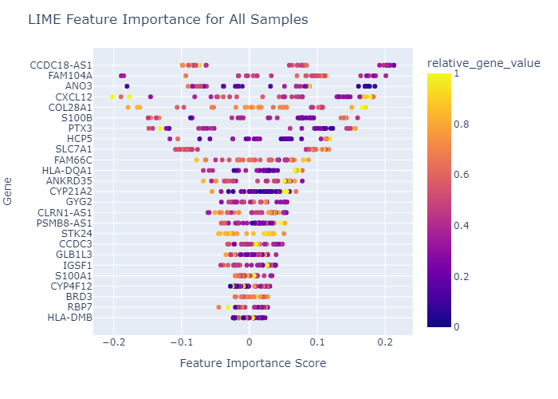
Interpretable Machine Learning Pipeline to Identify Genomic Signatures in Age-Related Macular Degeneration
Duy Ha, Patrick Yee, Qingxin Yuan, Sujitha Ravichandran, Tian Xia, Wanying Xu
Sponsor: Rinki Ratnapriya; Faculty Mentor: Arko Barman; Mentor: Maryam Khalid
Background
Results
Results
Age-related Macular Degeneration (AMD) deteriorates the central part of the retina and is a leading cause of vision loss in the elderly which affects millions of people in the United States alone.
Complexity: The disease is influenced by a combination of genetic variants, causing high dimensionality a problem
Current Challenges: Despite advances in genomics, difficulties in translating DNA variants to biological understanding have impeded progress in the specific genes causing AMD
Objective: Development of a Python Package
The project focuses on creating an interpretable machine-learning pipeline, implemented as a Python package.
This tool aims to identify crucial genomic signatures in AMD, enhancing our understanding of the disease.
A Broader Application - the pipeline and Python package are designed to be generalizable for other complex diseases.
SHAP (Shapley Additive Explanations):
pca
mrmr
rf
LIME (Local Interpretable Model-Agnostic Explanations):
AMD Progression leads to vision loss
Methods
Conclusion: Around 10 genes are sufficient to achieve the highest AUC score for MRMR
166 Patients
18056 Genes expression
KS, WRS, deseq2
Union 2486
Intersect 652
PCA, MRMR, Random Forest, Autoencoder
Best Performance for All Methods
Conclusion: Gene CCDC18-AS1, COL28A1, CXCL12, ANO3, FAM104A are found mostly associated with AMD
(Methods +xgboost) | Precision | Sensitivity | Specificity | F1 Score | AUC
PCA | 0.9289 | 0.9235 | 0.9628 | 0.9237 | 0.9696
MRMR | 0.9538 | 0.9471 | 0.9818 | 0.9470 | 0.9819
Random Forest | 0.9222 | 0.9176 | 0.9917 | 0.9163 | 0.9619
Autoencoder | 0.8845 | 0.8765 | 0.9389 | 0.8762 | 0.9512
Summary
We have developed machine learning models with up to 0.98 AUC to classify AMD patients.
We interpreted the machine learning model through SHAP and LIME and identified the possible genes related to the disease.
The MRMR model with best performance tend to exclude the gene that are correlated. Therefore, within python package, we also provide other model for user to choose.
We will extend this work to classify AMD patients with multiple stages.
SHAP, LIME
XGBoost
Conclusion: Overall, MRMR+xgboost perform the best for AMD patient classficiation.
Notes:
description for each method pca mrmr
background be more specific and less text
side by side for plots?
add std
object add python package?

Slide 5
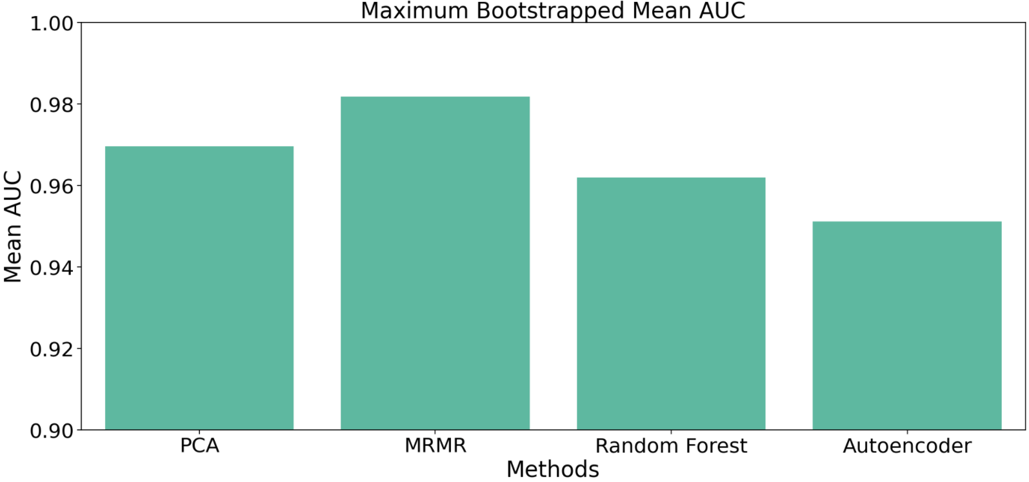
Interpretable Machine Learning Pipeline to Identify Genomic Signatures in Age-Related Macular Degeneration
Duy Ha, Patrick Yee, Qingxin Yuan, Sujitha Ravichandran, Tian Xia, Wanying Xu
Sponsor: Rinki Ratnapriya; Faculty Mentor: Arko Barman; Mentor: Maryam Khalid
Background and Objective
Results
Results
Age-related Macular Degeneration (AMD) deteriorates the central part of the retina and is a leading cause of vision loss in the elderly which affects millions of people in the United States alone.
Complexity: The disease is influenced by a combination of genetic variants, causing high dimensionality a problem
Current Challenges: Despite advances in genomics, difficulties in translating DNA variants to biological understanding have impeded progress in the specific genes causing AMD
Objective: Development of a Python Package
The project focuses on creating an interpretable machine-learning pipeline, implemented as a Python package.
This tool aims to identify crucial genomic signatures in AMD, enhancing our understanding of the disease.
Broader Application:
The pipeline and Python package are designed to be generalizable for other complex diseases.
SHAP (Shapley Additive Explanations):
LIME (Local Interpretable Model-Agnostic Explanations):
AMD Progression leads to vision loss
Methods
166 Patients
18056 Genes expression
KS, WRS, deseq2
Union 2486
Intersect 652
PCA, MRMR, Random Forest, Autoencoder
Best Performance for All Methods
 | Precision | Sensitivity | Specificity | F1 Score | AUC
PCA | 0.9289 | 0.9235 | 0.9628 | 0.9237 | 0.9696
MRMR | 0.9538 | 0.9471 | 0.9818 | 0.9470 | 0.9819
Random Forest | 0.9222 | 0.9176 | 0.9917 | 0.9163 | 0.9619
Autoencoder | 0.8845 | 0.8765 | 0.9389 | 0.8762 | 0.9512
Summary
We have successfully built machine learning models to classify patients into different disease levels with decent performance.
We interpreted the machine learning model through SHAP as well as LIME and identified the possible genes related to the disease.
We reduced the data dimensionality through feature selection and explored the selected genes vis-a-vis the disease levels to derive meaningful insights.
We incorporated the described pipeline into a Python package that can be used to analyze similar genomics or other omics datasets for any disease, with multiple model choices for users.
SHAP, LIME
xgboost
Notes:
add std
add the conclusion for table and first
mrmr is best and around 10 genes are sufficient
pca (+xgboost!)
object add python package?
table
develop ml model with 99 auc
first two about what we have done
last two we need to mention the future work (tend to exclude the gene that correlated) there is no one method fit all,
future work: multi class

Slide 6
XGBoost + RF Interpretation
LIME
(Local Interpretable Model-Agnostic Explanations)

